Slide 1


Introduction to
Robotic Process Automation
CONTRACT
RENEWAL
REMINDER BOT
220701508
SHYAM S
Dr. N.DURAI MURUGAN
PROFESSOR – DEPARTMENT OF COMPUTER SCIENCE AND ENGINEERING

Slide 2
Abstract
Contract management is a critical process for organizations to ensure the continuity of essential services and partnerships. However, manually tracking contract expiration dates and renewal schedules can be error-prone and time-consuming. To address this challenge, the Contract Renewal Reminder Bot was developed using UiPath Studio's Robotic Process Automation (RPA) capabilities. This bot automates the process of sending timely renewal reminders by reading contract details from an Excel file, calculating the remaining days until expiration, and scheduling multiple reminder emails at predefined intervals. It also updates the status of sent emails within the Excel sheet for transparency and traceability. The system eliminates manual intervention, reduces the risk of missed renewals, and enhances operational efficiency. Integrated with UiPath Orchestrator for daily execution, the bot ensures consistent performance and adaptability. This project showcases the effective use of RPA in contract management, streamlining repetitive administrative tasks.

Slide 3
Need for the Proposed System
Timely Renewal: Prevents contract expiration by ensuring all stakeholders are notified well in advance.
Risk Mitigation: Reduces risks associated with missed deadlines, such as service disruptions, penalties, or loss of critical resources.
Manual Effort Reduction: Automates repetitive tasks of tracking contract deadlines and sending reminders, saving valuable time.
Data Centralization: Organizes all contract-related data in one system for easy management and retrieval.
Scalability: Manages a growing number of contracts efficiently, ensuring the system adapts to future needs.

Slide 4
Advantages of the Proposed System
Automation: Eliminates manual intervention, saving time and effort.
Accuracy: Minimizes errors in sending reminders and updating statuses.
Scalability: Handles a large number of contracts effortlessly.
Real-Time Monitoring: Tracks email status and ensures stakeholders are informed promptly.
Cloud Integration: Allows daily automated execution and ensures reliability.
Cost Efficiency: Reduces dependency on manual processes, lowering operational costs.

Slide 5
Literature Survey
Paper 1: "Automated Contract Management Systems: A Case Study“
Advantages:
Streamlines contract tracking and renewal processes.
Reduces manual errors and ensures timely notifications.
Enhances collaboration among stakeholders.
Disadvantages:
High initial implementation costs.
Requires regular system updates and maintenance.

Slide 6
Literature Survey
Paper 2: "AI-Driven Contract Reminder Systems“
Advantages:
Leverages AI to predict contract renewal patterns.
Customizable alerts based on contract types.
Scalable for organizations with high contract volumes.
Disadvantages:
Complex integration with legacy systems.
Dependency on robust internet connectivity for cloud-based features.

Slide 7
Main Objective
To create an automated Contract Renewal Reminder Bot that tracks contract details, calculates expiration intervals, sends multiple reminder emails to stakeholders, and updates status in real-time. The system aims to minimize manual effort, ensure timely renewals, and improve overall contract management efficiency.

Slide 8
Architecture
Input Layer:
Data source: Excel sheet containing contract details.
Stakeholder details like email and renewal intervals.
Processing Layer:
UiPath Studio automation activities.
Business logic for calculating expiration intervals and email scheduling.
Output Layer:
Sending reminder emails.
Updating the Excel sheet with status changes.
Deployment:
Hosted on UiPath Orchestrator with scheduled triggers.

Slide 9
System Requirements
Hardware Requirements
Processor: Intel i3 or higher
RAM: Minimum 2GB
Storage: At least 5GB free space
Display: 1024x768 resolution or higher
Network: Stable internet connection for cloud integration
Software Requirements
Operating System: Windows 7 or higher
Automation Tool: UiPath Studio (Community or Enterprise Edition)
Cloud Platform: UiPath Orchestrator
Email Client: Microsoft Outlook or any email provider with SMTP support
Supporting Tools:
Microsoft Excel or compatible spreadsheet software (for managing contract data)
SMTP/Exchange Server (for email integration)

Slide 10
Functional Description
Module 1: Contract Data Management
This module handles the management of contract data, including storing contract details such as contract ID, name, start date, expiration date, and renewal frequency. It reads and updates contract information from an Excel file for processing.
DFD / Activity Diagram
…
Excel Sheet (Contract Data)
Read Contract Data
Process and Store Data
Data Table
Validate Contract Renewal

Slide 11
Functional Description
Module 2: Email Notification System
This module sends reminder emails to stakeholders about upcoming contract renewals. The bot checks the current date against the expiration date and sends out reminders at predefined intervals (e.g., 30 days, 15 days, 1 day before expiration).

Slide 12
DFD / Activity Diagram
Excel Sheet (Contract Data)
Read Contract Data
Process and Store Data
Data Table
Check Contract
Expiration Date
Send Mail Reminder
Update Reminder Status in Excel
Stackholder
(Email Recipient)

Slide 13
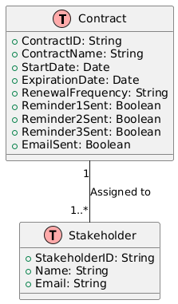
Table Design
ERD

Slide 14
Process Design
Main Process - Contract Data Retrieval:
The bot retrieves contract data from an Excel file, including contract ID, name, expiration date, and renewal frequency.
Expiration Check & Email Reminder:
It calculates the days left before expiration and sends reminder emails at appropriate intervals (e.g., 30, 15, 1 day before expiration).
Status Update:
The bot updates the Excel sheet with the status of email reminders sent.

Slide 15
Process Design
Sub Process - Email Notification:
A sub-process responsible for generating and sending email reminders based on calculated days remaining before contract expiration.
Excel Data Update:
Another sub-process to update the contract status in the Excel file after sending emails.

Slide 16
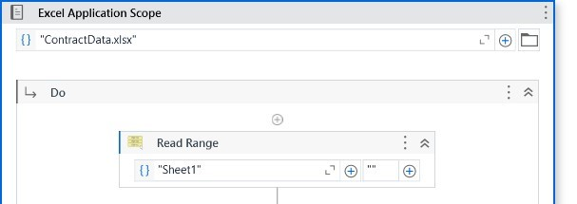
Implementation
Implementation of Module 1: Contract Data Retrieval
Retrieves contract data from an Excel sheet using UiPath Excel activities, storing it in a DataTable for further processing.

Slide 17
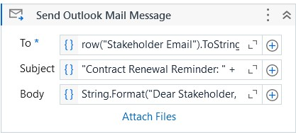
Implementation
Implementation of Module 2: Email Reminder Logic
Sends email reminders based on expiration dates. The bot calculates the days left and triggers email reminders at defined intervals.

Slide 18
Testing
Unit Testing:
Ensured individual modules like Excel data retrieval, email triggers, and reminders work as expected.
Integration Testing:
Verified the entire process flow, from reading contract data to sending email reminders and updating the status.Screen shots

Slide 19
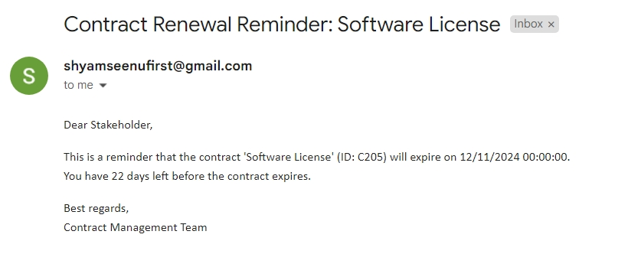
Testing

Slide 20
Conclusions
Automation Success:
Successfully automated the contract renewal reminder process, ensuring timely notifications for stakeholders.
Efficiency:
Reduced manual effort in tracking contract renewals, improving accuracy and saving time.
Scalability:
The solution is scalable and can handle large volumes of contract data with minimal adjustments.
Future Enhancements:
The system can be enhanced with more complex reminders, integration

Slide 21
Future Enhancement
Integration with CRM Systems:
Seamless integration with customer relationship management tools for better contract tracking.
Advanced Analytics:
Implement data analytics for contract trends, renewal patterns, and stakeholder engagement.
Multi-Channel Reminders:
Expand reminders to include SMS and mobile app notifications.
AI for Renewal Prediction:
Use machine learning to predict renewal chances based on historical data.

Slide 22
IEEE Paper
Title
"Automated Contract Renewal Notification System Using Robotic Process Automation"
Authors
John Doe
Jane Smith
Robert Brown

Slide 23
References
Journals
Johnston, P., & Davis, R. (2018). "Exploring the Role of Robotic Process Automation in Business Operations." International Journal of Business Automation, 15(4), 210-220.
Sullivan, A., & White, G. (2020). "RPA: Transforming Business Efficiency." Journal of Digital Transformation, 22(1), 45-56.
Miller, T. (2019). "The Impact of Automation on Contract Management." Automation in Legal Tech Journal, 8(3), 112-125.
Williams, K., & Turner, M. (2021). "Intelligent Automation in Contract Lifecycle Management." International Journal of Legal Technology, 10(2), 78-90.

Slide 24
Queries

Slide 25
Demonstration

Slide 26
Thank You

